Slide 1
Climate resilience
Metrics and indicators

Slide 2
Why look at indicators of resilience?
Climate change poses major risk to WASH beyond current sustainability
Utilities and HICs developed sophisticated responses (e.g. Seattle), much less work in LMICs
Some very good work (e.g. GWP and UNICEF) have developed wide range of factors to consider for resilience
But remains lack of simplified indicators suitable for routine use by water suppliers, governments and donors/NGOs

Slide 3
Metrics of resilience
Need to consider multi-faceted nature of resilience
Small number (e.g. recent review identified 176 indicators used more widely in climate resilience!)
Easy to use and score (semi-quantitative)
Do not need to be perfect, but do need to help support action

Slide 4
How could such metrics be used?
National/sub-national level
  Identify particular communities or regions of highest priority
  Identify systemic failures requiring design, policy, regulatory or operational change at scale
  Both requiring consolidation and analysis of large data sets
Community level
  Score card approach
  Use to generate discussion within communities about risks and solutions

Slide 5
Multiple domains of resilience
Infrastructure (source protection)
Environment (catchment)
Management (community)
Community cohesion and structure (community)
Supply chains
Institutional support (local govt)
Policy (national govt)
Climate change (storylines)
Catchment, community governance, government support, supply chains
Infrastructure, source protection, community engagement

Slide 6
Proposed indicators
Indicator | Means of measurement
Source protection | Sanitary inspection, water quality data. Either existing records or assessment.
Catchment | Geospatial analysis (we use Google earth), but may include some visual assessment
Management | Focus group discussion, key informant interviews. Focused on management committee/operator
Cohesion and structure | Focus group discussion, key informant interviews. Looks at wider community cohesion and engagement
Supply chains | Geospatial analysis, focus group discussions, key informant interviews. Look at sources of spares, routes to community, stockpiles
Local government support | Focus group discussion (community), key informant interviews (local govt). What ongoing support is offered to water operators

Slide 7
Measurement of indicators
Score | Description
1 | No protective measures against risk of damage and inundation in place, no data on trends in yield, very high sanitary risk
2 | Limited protective measures against risk of damage and/or inundation with numerous risks still present, high sanitary risk
3 | Partial protective measures against risks of damage and/or inundation in place, but several risks still present, medium sanitary risk
4 | Protective measures against risks of damage and inundation in place, but at least one risk still present, low sanitary risk
5 | Comprehensive protective measures against all risks of damage and inundation of supply in place, no evidence of reducing yield, very low sanitary risk
Each indicator considers multiple factors
5 scenarios defined ranging from very low resilience (1) to high resilience (5)
Integrate range of quantitative and qualitative data and involve a degree of judgement to assignment a score on the scale

Slide 8
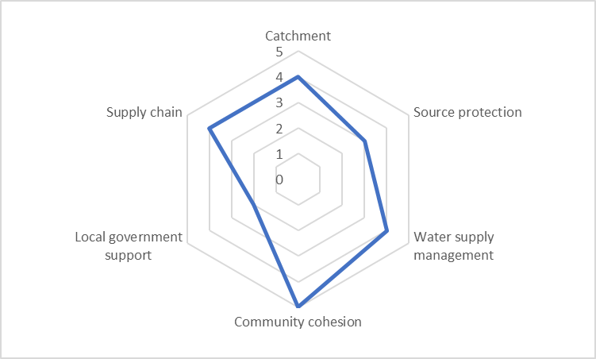
Amalgamating into a single score
Amalgamated score | Resilience | Priority | Qualifier | Action
25-30 | Very high | Very Low | If score reduce because of failure on one indicator action required | Maintain performance
19-24 | High | Low | Action focused on specific indicator failures | Limited improvements
13-18 | Medium | Medium | Likely to be across multiple indicators | Substantial improvements
7-12 | Low | High | Action required across all indicators | Large-scale improvements
6 | Very low | Very high | Action required across all indicators | Systemic improvements
Note: policy indicator not included in amalgamated score when looking within one country, but would for comparisons between countries

Slide 9
Integrating climate
Focus on meaningful information
Climate storylines being developed looking at drivers of major events to help inform planning and preparedness
Storylines focus on impacts rather than frequency of events to help users identify and plan action

Slide 10
Current activities
How tough is WASH? (initial findings published in 2021 https://climateresilientwash.blogs.bristol.ac.uk/research-areas/home/
Sanitation and Climate: Assessing Resilience and Emissions (SCARE) - GHG methodology finalised in late 2020, building on CACTUS; fieldwork starts early 2021
Guidance on climate vulnerability assessment for WASH (WHO) – draft available in 2021, country pilots (Nepal, Bangladesh) 2021
Climate resilience modules for WASH-FIT (already being tested as part of CRESH)

Slide 11
Is resilience simply part of sustainability or a separate, complementary construct?
One argument is that resilience should simply be addressed through our current (admittedly rather weak) sector tools for looking at sustainability
Alternative view is that how we measure and understand resilience (spanning known-knowns to unknown-unknowns) is distinct from approaches to sustainability (which tend to focus on known-knowns)
But will multiple metrics enhance or confuse?

